Slide 1
Vibration-Based Condition Monitoring
System for Rotating Fans
Name | Matric no
Adrien Pierre MALCOIFFE Wei YAGE | MEM241042 MEM241043
Github:
https://github.com/Ayunoo/Condition-Monitoring-Project
Youtube video:
https://youtu.be/3-jeOoLR8ko

Slide 2
Part 1：System Overview & Data Acquisition
Part 2：Data Transmission & Preprocessing
Part 3：Fault Simulation & Signal Analysis
Part 4：Feature Extraction & Intelligent Diagnosis
Part 5：Model Evaluation & Result Display

Slide 3
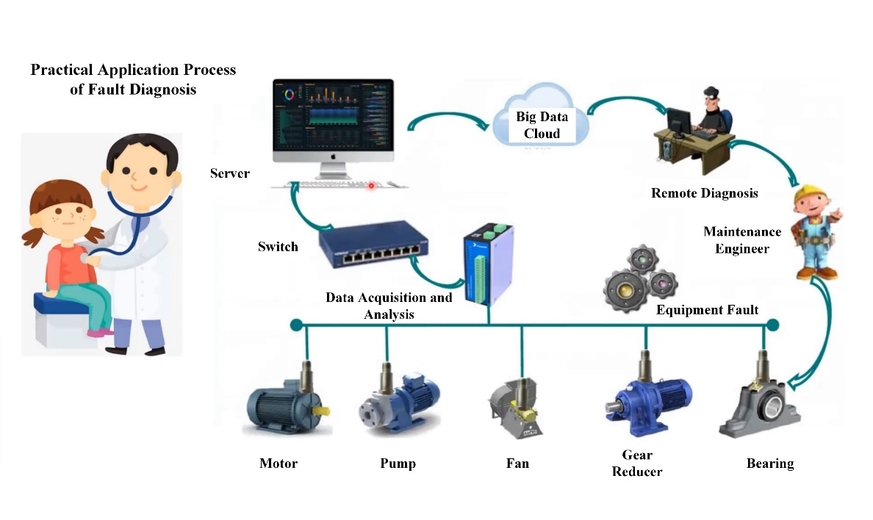
Objectives
Develop a simple and efficient condition monitoring system for rotating fans.
Collecting real-time vibration data during fan operation using MPU6050 sensors and Arduino Uno
Analyzing the data through signal processing and machine learning techniques
Detecting and classifying typical faults such as mechanical imbalance in real time.

Slide 4
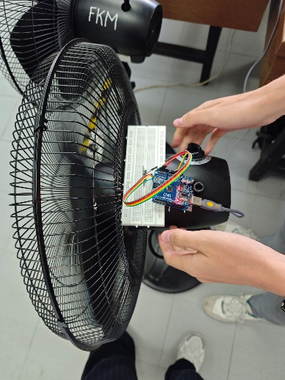
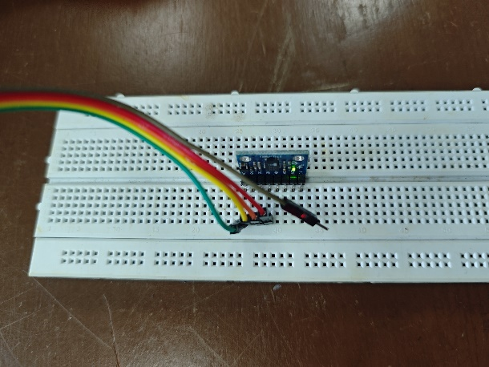
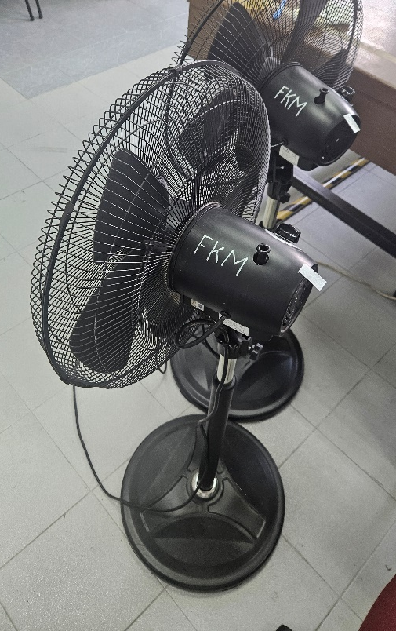
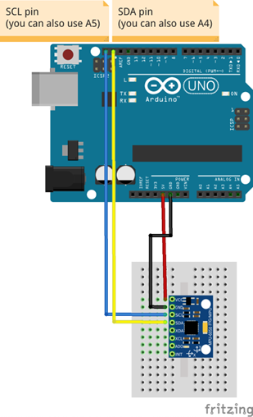
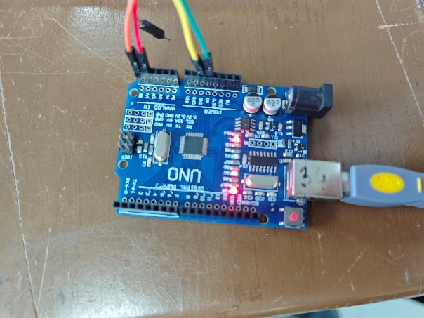
Part 1：System Overview & Data Acquisition
I. Data collection:
（1）Sensor Selection: MPU6050 sensor
A three-ais accelerometer
（2）Control hardware: Arduino Uno
For the data acquisition
（3）Acquisition content: including vibration signals and acceleration along each axis
x
y
z
(1)
(3)
(2)

Slide 5
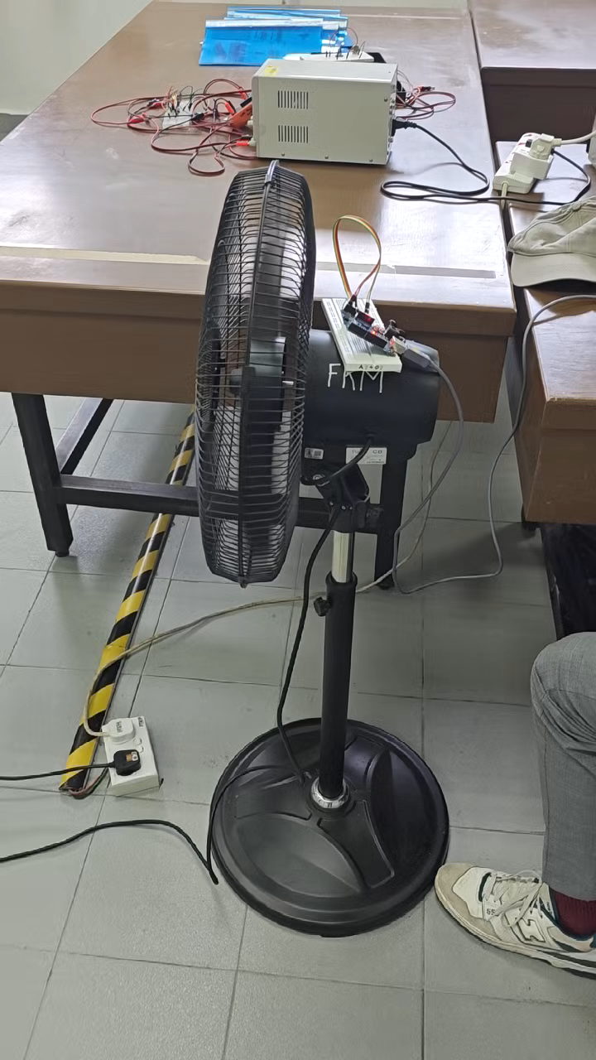
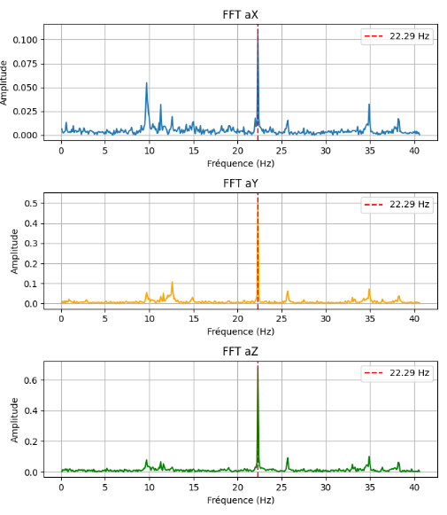
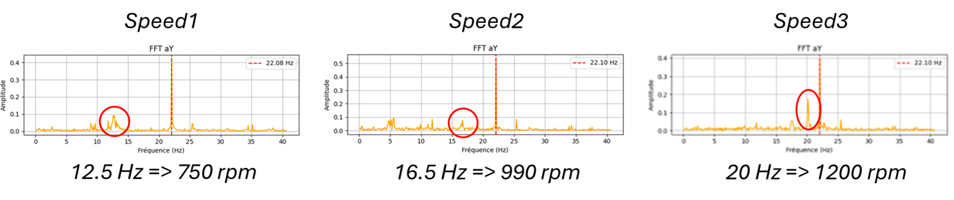
Part 2：Data Transmission & Preprocessing
(1) Data transmission: Raw data transmitted to the computer
(2) Data storage: Save the vibration signal
(3) Signal Analysis: Applying FFT to analyze frequency domain
(4) Fans faults detected after analyzing harmonics

Slide 6
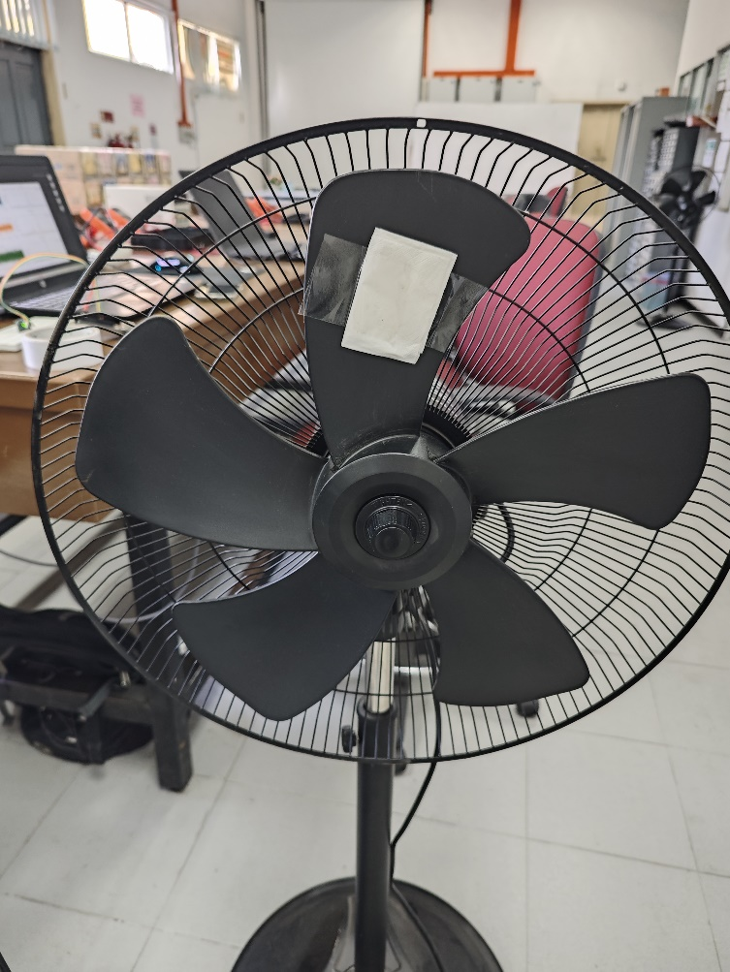
Part 3：Fault Simulation & Signal Analysis
Failure simulation methodology:
Purposely adding a small piece of paper on the fan blade
This setup facilitates subsequent comparative analysis between normal and faulty states
At the end, we will be able to create an alert if unbalance occurs.

Slide 7
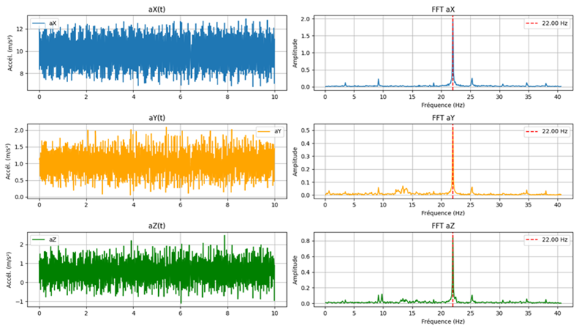
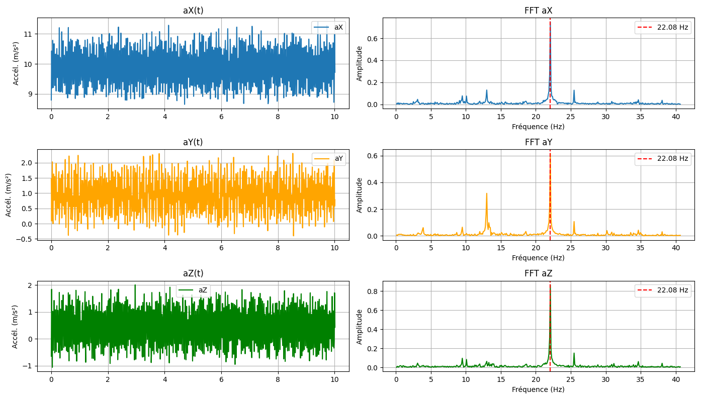
Part 3：Fault Simulation & Signal Analysis
normal condition
unbalanced condition
In the Y-axis vibration signal, the amplitude of the 12.5 Hz peak increases by 76% in unbalanced condition.

Slide 8
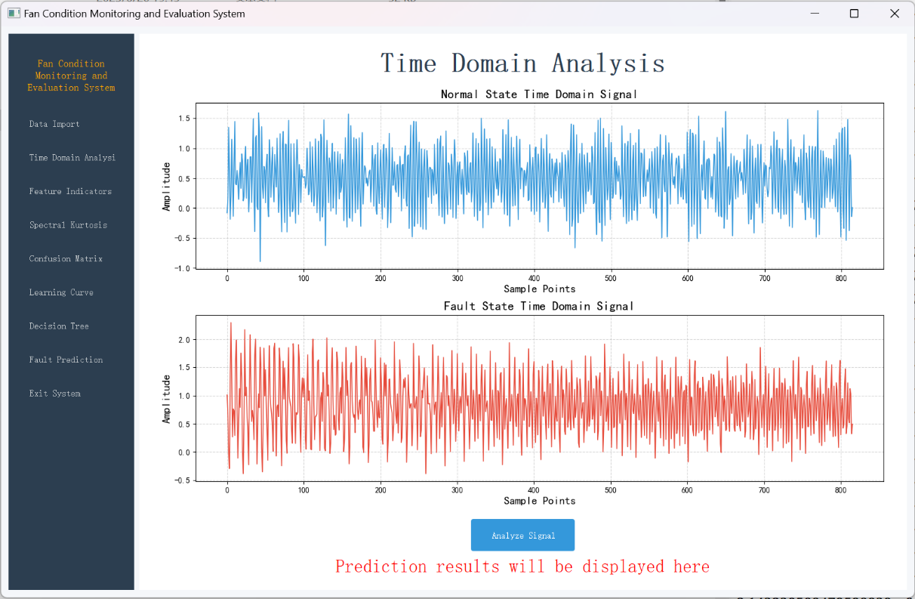
Part 4：Feature Extraction & Intelligent Diagnosis
Software Identification and Diagnostics Module:
The signal processing and analysis part includes modules for signal receiving, storage, and data analysis.
A dedicated tool to extract various time-domain and frequency-domain features from the signals.
The system integrates a decision tree-based machine learning model to automatically classify and identify the fan's operating state.

Slide 9
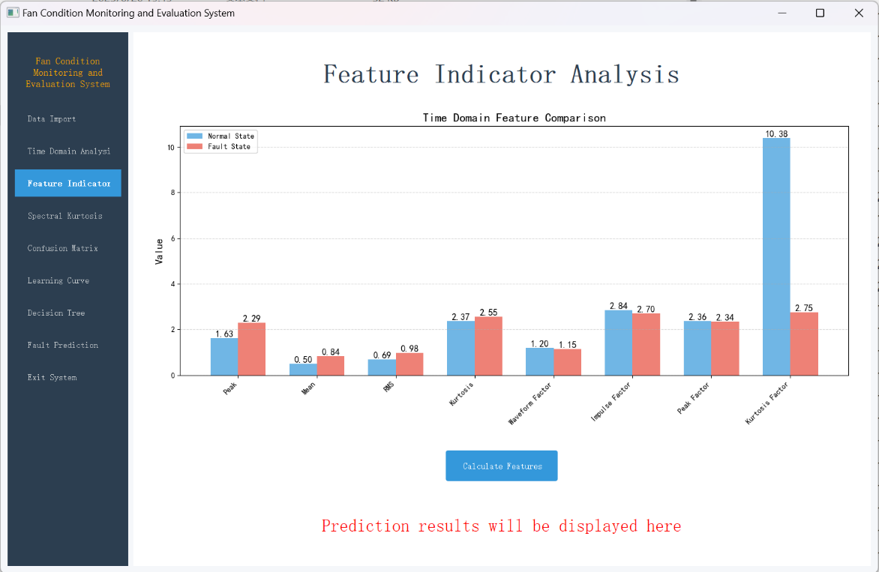
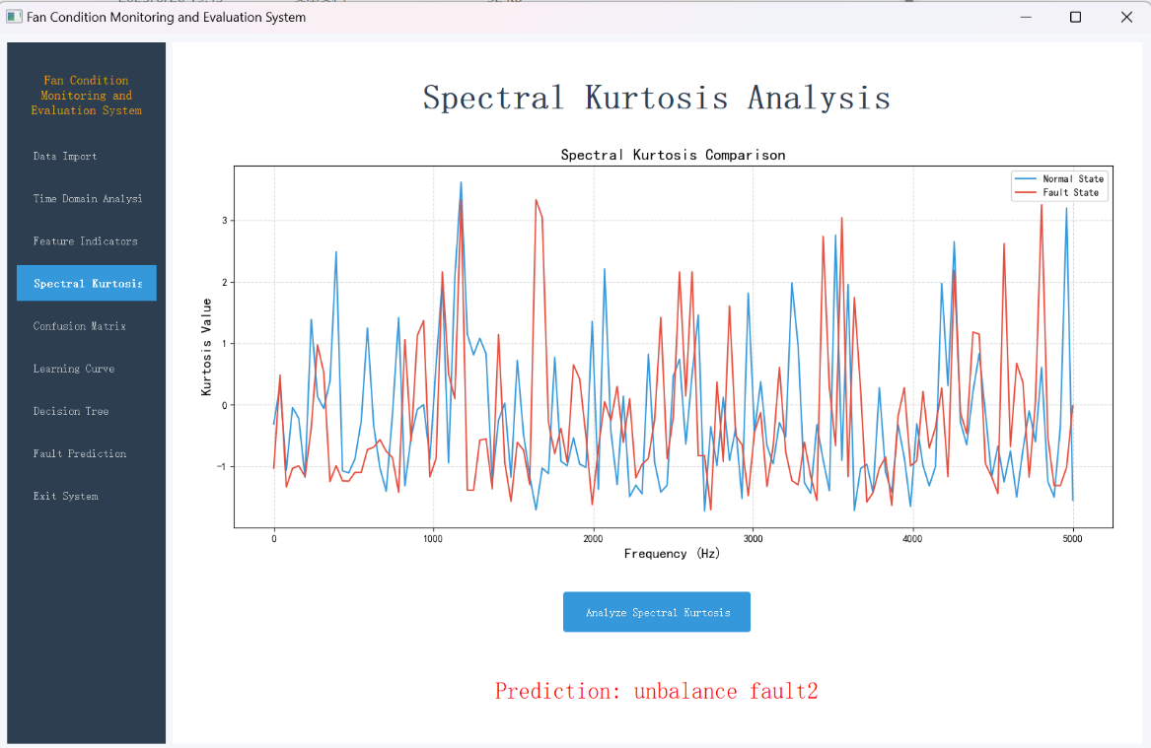
Part 4：Feature Extraction & Intelligent Diagnosis
It automatically calculates key indicators such as peak value and RMS for time-domain features, and kurtosis, waveform factor, etc. for dimensionless features.
These help quantify differences between normal and faulty states.

Slide 10
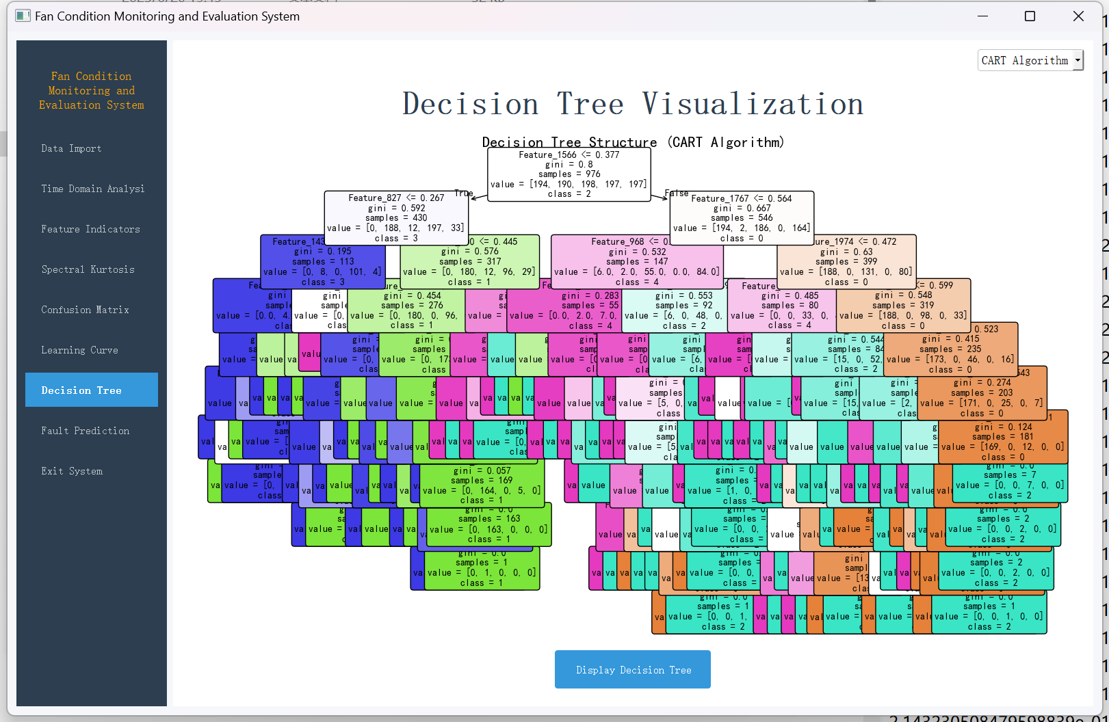
Part 4：Feature Extraction & Intelligent Diagnosis
Real-time identification of 5 fan states: speed1/2/3, unbalance fault1/2
Decision tree-based classification trained on input features and outputing current fan condition
Displayable decision tree and visual diagnosis

Slide 11
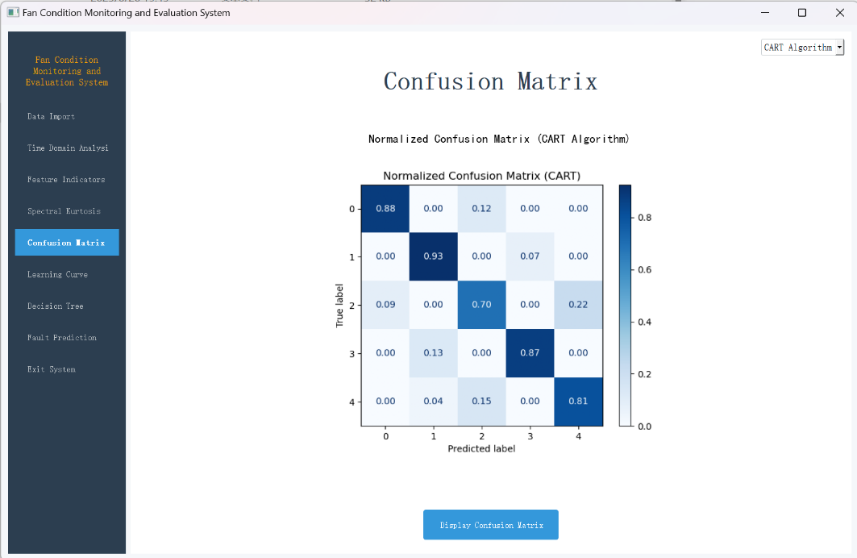
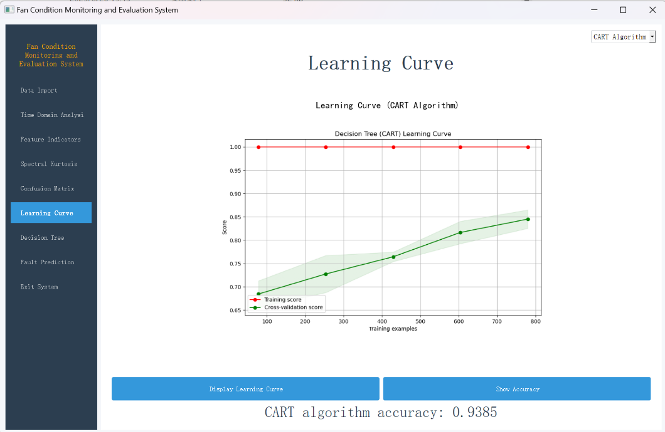
Part 5：Model Evaluation & Result Display
The confusion matrix module shows the model’s performance in multi-class fault classification
The accuracy curve tracks training and validation accuracy over epochs

Slide 12
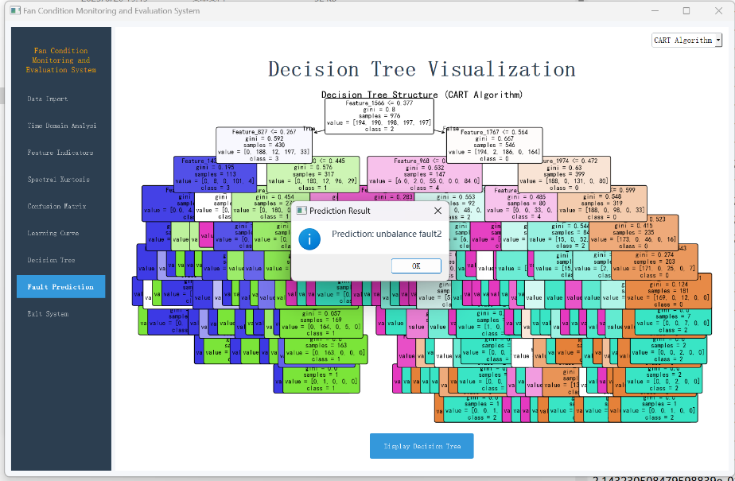
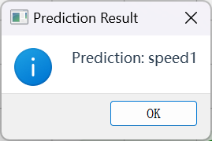
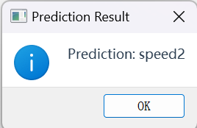
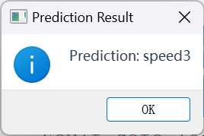
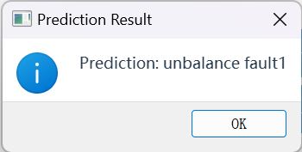
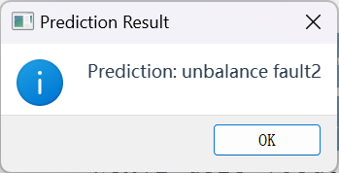
Part 5：Model Evaluation & Result Display
Diagnosis process: visual, interpretable, traceable, and providing users with a clear and transparent intelligent fault diagnosis experience.
All states were successfully identified, demonstrating the system’s effective fault warning capability.

Slide 13

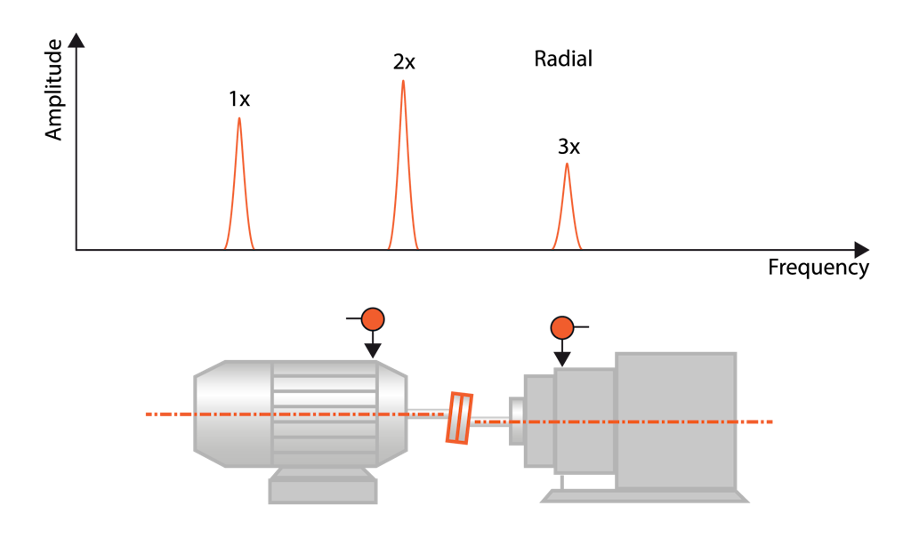
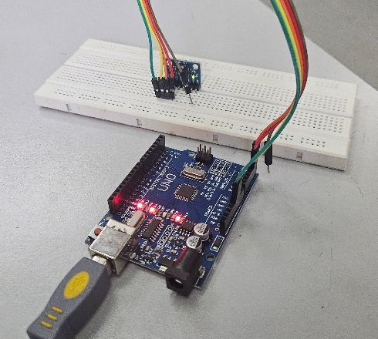
To go further…
(1) Turning it into a 24h/24h working system
(3) Detect other issues like misalignement
(3) Improve the overall design of the sensor

Slide 14
Thank you for listening

